Slide 1

Dissertation CMP – 7027X Presentation Predicting energy consumption
Prepared by:
Ravi Ranjan
100374026
Supervisor:
Mr. Wanqing Zhao

Slide 2
Introduction
Machine Learning (ML) technology improved our life.
In 18TH century ML has gained attention in time series forecasting. First used in medical sector.
the ability to do work in a certain amount of time is energy but, here the concept is the same, but the source is different. We are talking about the source of energy i.. e, electricity, gas, water, and crude oil, which is vital for the community to accomplish their regular task.
Along with global population growth, there is a corresponding boost in energy demand and usage.
the building sector is the largest energy-consuming sector in the world and accounts for over one-third of final energy consumption globally.

Slide 3
Problem
Burning fossil fuels, they emit greenhouse gas which produce global warming or climate changes.
According to European Commission, EU countries depended on Russia natural gas to generate electricity.

Slide 4
AIM
This research focuses on the use of different algorithms on a single dataset to find the
best algorithms to predict the energy consumption for the future. This paper shows how
the dataset is trained with different algorithms and produced different accuracy and
compares them with each other and predicts the values for that. Also, this experiment
shows the desired graph and tables related to the energy prediction outcome.

Slide 5
Objectives
1
Study about the existing methodologies and techniques used for predicting energy consumption.
2
Implementation of 4 machine learning algorithms(SVR, KNR, MLP, RFR) and evaluation.
3
Comparison between the results and highlighting the best algorithm.

Slide 6
Dataset
The Zenodo provides Household electricity consumption data and Meteorology in Sceaux (Paris, France) of a total of 17295 time-series and 13 variables. The time resolution is of 2 hours. The dataset tracked energy use in a French home for four years, from January 1, 2007, to November 12, 2010. Also, Dataset contains wind speed, Precipitation, snowfall, cloud cover, voltage, and global reactive power.

Slide 7
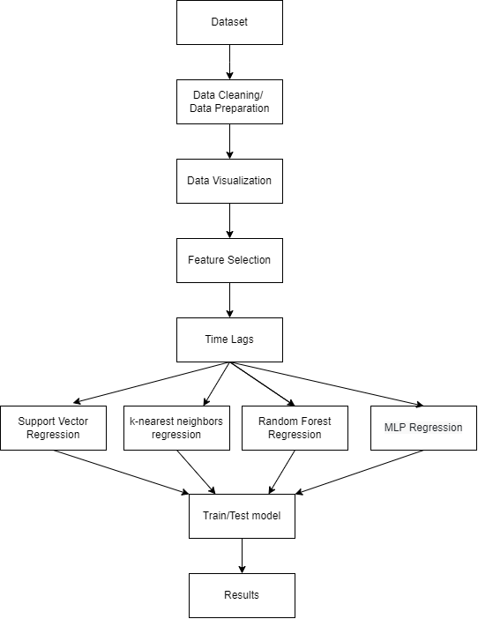
Methodology Design

Slide 8
Data Cleaning
Handling missing values and replace with mean and median.
Checking duplicates values and eliminating.
Remove outliers

Slide 9
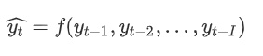
Time Lags
It is used to measure auto-correlation i.e., how past values of a variable influence its future values, thus unlocking predictive value.
It is used because Outcomes would be more exact and predicting accuracy would increase.
It is important to use time lags because to understand seasonality and form the basis for forecasting.
Yt is the estimated forecast, time lags are(Yt-1 , Yt-2 ,. . . . . . . . . ,Yt-i)

Slide 10
Machine learning Algorithms
Support Vector Regression (SVR)
K- neighbor Regression
Multilayer Perceptron Algorithm Regression (MLP)
Random Forest Regression

Slide 11
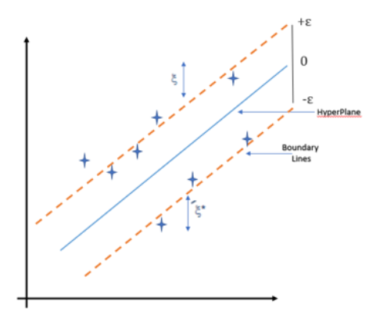
Support Vector Regression (SVR)
Similar to SVM.
SVR is used for continues values.
Hyper plane - It is a dividing line separating two data categories in a higher dimension than the real dimension
Kernel – this process is performed in high dimension so to collect and map all the data points in high dimension it used kernel. Different kernel like (RBF, POLY, LINEAR).
Boundary line – it shows the margin between two data points (Pedamkar 2022).

Slide 12
K- neighbor Regression
supervised learning that utilizes proximity to produce regression, or predictions about how a particular data point will be grouped.
it relies on k -nearest neighbor, and then based on the neighbor class it classifies the whole data.
To determine each neighbor’s weight, kernel function is frequently used.
Large K values improve precision by lowering background noise.
if the value is close to k, then the quality of the prediction is good or if the value is far from the k value then its prediction is poor quality.

Slide 13
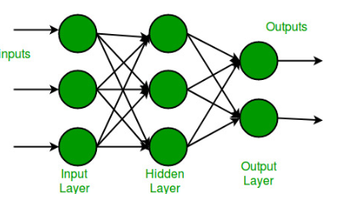
Multilayer Perceptron Algorithm Regression (MLP)
The multilayer perceptron is an example of an Artificial Neural network.
Each layer contains neuron.
An MLP is characterized by several layers of input nodes connected as a directed graph between the input and output layers.
Each node, apart from the input nodes, has a nonlinear activation function.
In every iteration, weighted sums move ahead through all the layers, and the mean squared error is calculated.

Slide 14
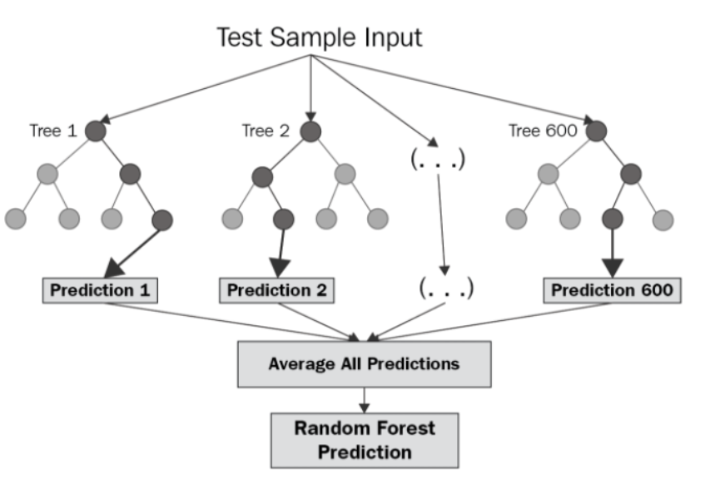
Random Forest Regression
collection of decision tree is called random forest.
It use ensemble learning method for regression.
Ensemble learning method is a technique that combines predictions from multiple machine learning algorithms to make a more accurate prediction.
constructing several decision trees during training time and outputting the mean of the classes as the prediction of all the trees.
It is one of the powerful and accurate.

Slide 15
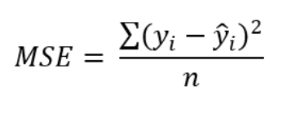
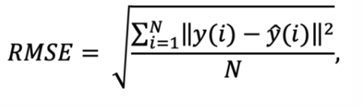
Evaluation
Mean Squared Error (MSE)
Root Mean Squared Error (RMSE)

Slide 16
Implementation and Results

Slide 17
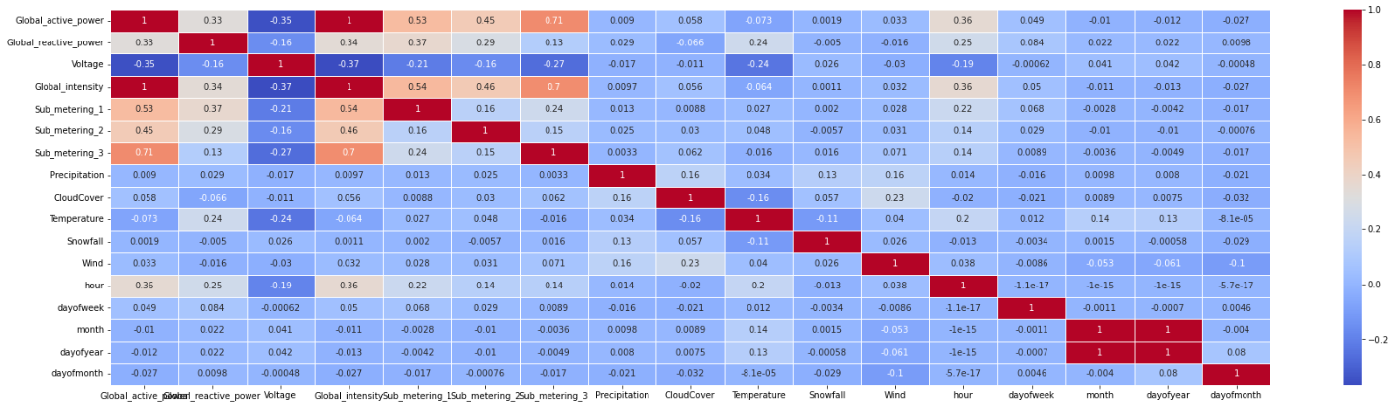
Feature Selection
global intensity which has a complete 1 so it is fully correlated to global active power.
submetering 1,2,3 are correlated to global active power with the value of 0.53,0.45,0.71 respectively.
Hour features are also related to the target variable but not fully correlated which is only 0.36.
global reactive power is less correlated with the target variable but still, it’s related with a value of 0.33.

Slide 18
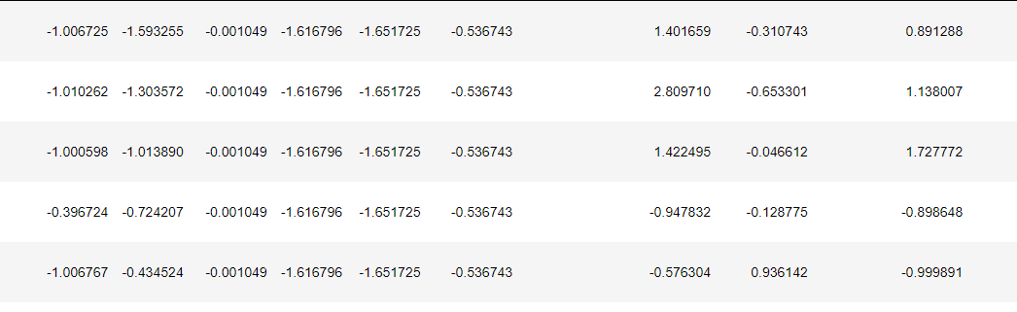
Standardization
used StandardScaler/ MinMaxScaler libraries from sklearn because they eliminate the mean and adjust every feature to unit variance
Dataset are in unorganized scenario that is difficult to understand that's why we use standardization.
It can assure quality, lessen uncertainty and guessing, promote efficiency, and improve user satisfaction.

Slide 19
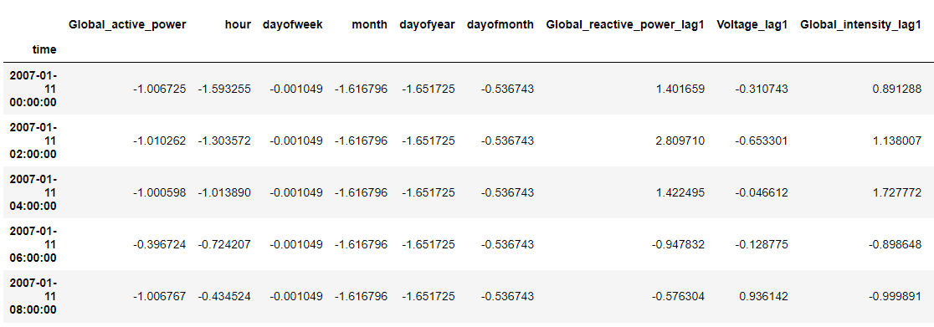
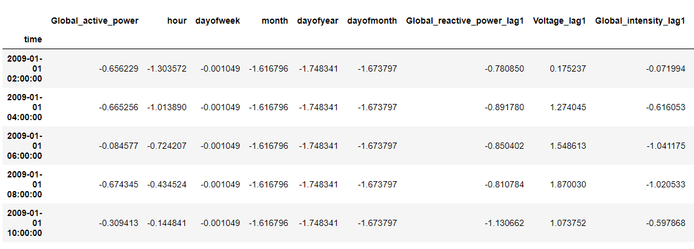
Train Test Spilt
Training set
The data from
2007 to 2009 is for training data and from 2009 to 2010 is for testing data.
Testing set

Slide 20
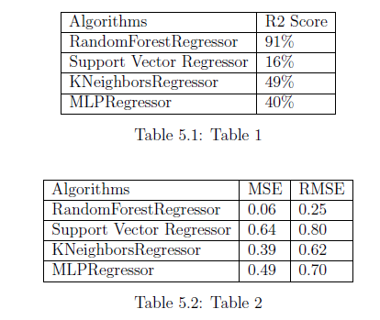
Results
Without scaling results
RFR works really well with less MSE and RMSE.
SVR less efficient AS compared to other model.
R2 is a measure of the goodness of fit of a model.
R2 score measure of how well the regression predictions.

Slide 21
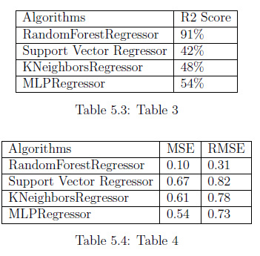
used StandardScaler method to scale the whole dataset.
Accuracy of SVR, KNR, MLP is increased.
Accuracy of RFR is remain same.
Still SVR is less efficient as compared to others.
MSE and RMSE is still high for SVR,KNR,MLP.

Slide 22
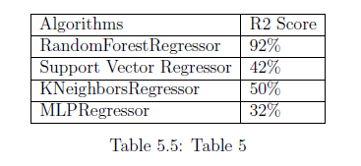
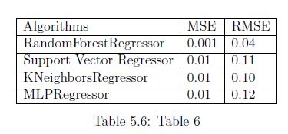
used MinMaxScaler method to scale the whole dataset.
Accuracy of KNR, SVR, RFR is increased.
MLP accuracy is decreased as compared to previous one.
The MSE of all algorithms is less which is good.
RMSE value is also less for all model.

Slide 23
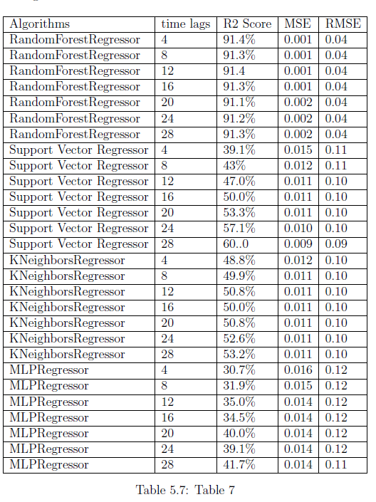
Stimulation of different time lags with possible errors.
Started with 4 time lags and gone to 28 lags.
Accuracy is almost similar to all of the lags which are around 91% with almost the same MSE and RMSE is approximately 0.001 and 0.04 respectively.
All the remaining model accuracy is increasing with the increase in time lags.

Slide 24
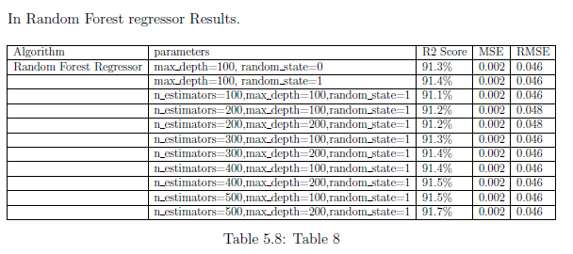
Parameters
Random Forest Regressor
Best work when n_estimators is 500, max depth is 200 and rondom state is 1.
n estimators – it tells the number of trees in the forest.
Max depth – it is the maximal depth of the tree.
Random state - regulates the unpredictability of the bootstrap samples used to construct trees.

Slide 25
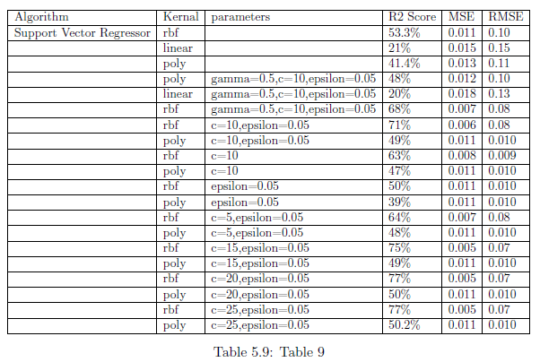
Support vector regressor
Best work when kernel is ‘rbf’, c= 25, epsilon=0.05.
Ref- this kernel is used to finding the regression line between the data.
Gamma-parameter defines how far the influence of a single training example reaches.
c – it is the Normalization factor.
Epsilon - It identifies training loss function for values forecasted.

Slide 26
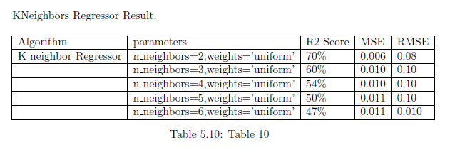
k neighbor regressor
Best work when, n neighbors is 2, weight is ‘uniform.
n neighbors = it is used to denote the number of neighbors.
Weights – it is used to predict the possible values.

Slide 27
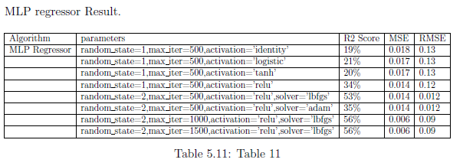
MLP regressor
Best work when random state 2, max iter is 1500, activation function is ‘relu’ and solver is ‘lbfgs’.
‘relu’ – it is a rectified linear unit function.
Solver – it is for optimizing the weight and ‘lbfgs’ – optimizer of newton methods.
Max iter – denotes the maximum iteration in the algorithm.
random state - numbers for the initialization of weights.

Slide 28
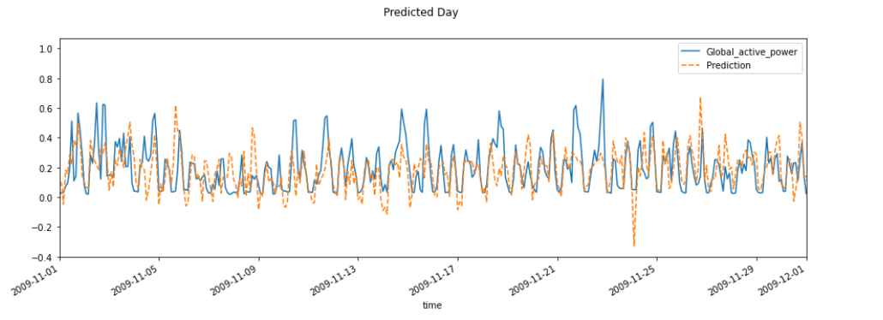
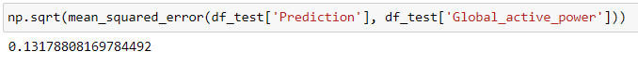
Final Result
Predicted the Global active power using test set data with only 0.13 MSE (mean squared error).

Slide 29
Conclusion
selected the important features using the correlation between all features.
Taken 12 lags to execute all the models it gives the best results.
The next step is standardization, MinMaxscaler, which I have used on the dataset to scale the data.
Then implemented the 4 regression algorithms because the data is continuous so we can use only the regression algorithm.
After performing all the tasks with stimulation, the best performance is achieved by the RFR with an accuracy of 91.7% and Mean Squared Error (MSE) is 0.001, Root Mean Squared Error (RMSE) is 0.043 which is low as compared to other algorithms.
Meanwhile, the algorithm which not worked very well is the Multi-layered perceptron (MLP), which only gives 61% of accuracy.
Then, predicted the Global active power and compared the prediction result with the original global active power values and got a 0.13 Mean Squared error on the prediction.

Slide 30
References
Amber, K., Ahmad, R., Aslam, M., Kousar, A., Usman, M. & Khan, M. S. (2018), ‘Intelligent techniques for forecasting electricity consumption of buildings’, Energy 157, 886–893.
A, P. V., J, T. H., J, S. S. & JJ, A. P. (2020), ‘Electricity consumption and meteorology in sceaux’. URL: https://doi.org/10.5281/zenodo.3608970.
Awad, M. & Khanna, R. (2015), Support vector regression, in ‘Efficient learning machines’, Springer, pp. 67–80.
Bakshi, C. (2020), ‘Random forest regression (accessed on 19-08-2022)’, https://levelup.gitconnected.com/random-forest-regression-209c0f354c84.
Biswas, M. R., Robinson, M. D. & Fumo, N. (2016), ‘Prediction of residential building energy consumption: A neural network approach’, Energy 117, 84–92.
Chou, J.-S. & Tran, D.-S. (2018), ‘Forecasting energy consumption time series using machine learning techniques based on usage patterns of residential householders’, Energy 165, 709–726.
Dong, B., Li, Z., Rahman, S. M. & Vega, R. (2016), ‘A hybrid model approach for forecasting future residential electricity consumption’, Energy and Buildings 117, 341–351.

Slide 31
Thank You

